Slide 1


Conditional Formatting in Power BI
Presented By – Group 10

Slide 2
Team Members
Tejas MS – Introduction to Conditional Formatting
Smita Ravi Naik – Why Use Conditional Formatting
Madhusudhan R – Where Can You Apply It
Vinod Kumar – Types of Conditional Formatting
Mohammad Faiz – Applying Conditional Formatting
Veena – Example’s Background Colour, Icon
Gaurav Ranjan Samal - Field Value Based Formatting

Slide 3

CONTENTS
1. Introduction to Conditional Formatting
2. Why Use Conditional Formatting?
3. Where Can You Apply It?
4. Types of Conditional Formatting
5. Applying Conditional Formatting
6. Example – Background Color & Icon
7. Field Value Based Formatting

Slide 4


01
Introduction to Conditional Formatting : Tejas MS

Slide 5

Introduction to Conditional Formatting
"Good Afternoon, Today, we're going to talk about a powerful feature in Power BI called Conditional Formatting. At its core, conditional formatting is all about making your data tell a story at a glance. It changes how your visuals look, not based on static settings, but on the underlying data itself. The main purpose is to improve data readability and highlight key insights without requiring a deep dive into every number. Think of it as a dynamic layer on your reports that instantly guides your attention to what matters most. It's an essential tool for creating a truly effective and engaging dashboard."

Slide 6
Where you use Conditional formatting?
"So, where can you use this? Conditional formatting is incredibly versatile. It's most commonly used in Tables and Matrices to highlight specific cells. But it doesn't stop there. You can apply it to Cards to change the color of a key performance indicator based on a target, or even to charts to dynamically color a bar or a data point. This wide availability means you can bring your most critical data to life across your entire report."

Slide 7
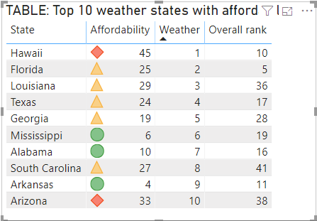
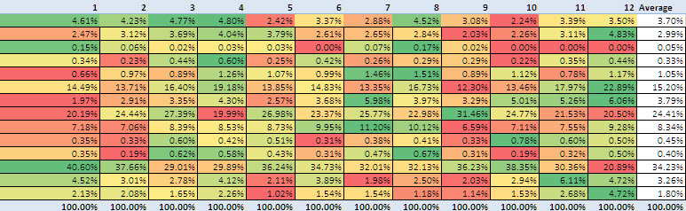
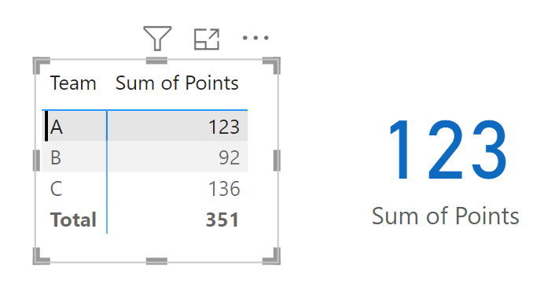
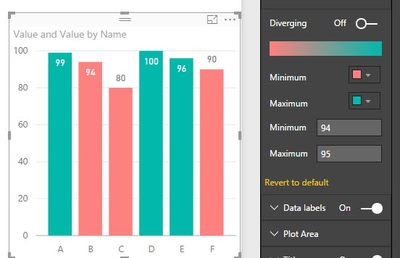
TABLE Formatting
MATRICES Formatting
CARD Formatting
BAR CHART Formatting

Slide 8
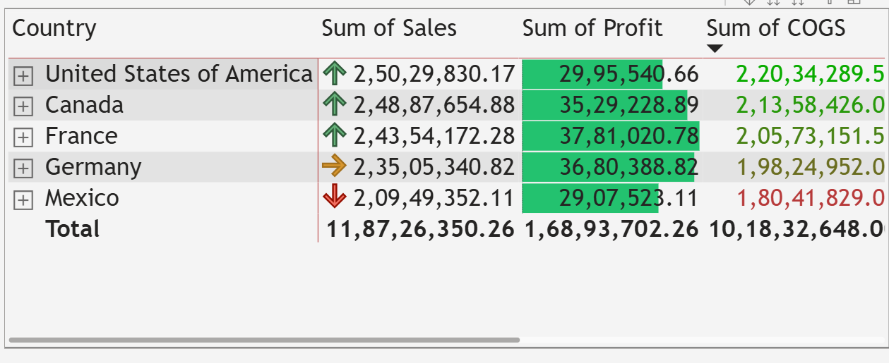
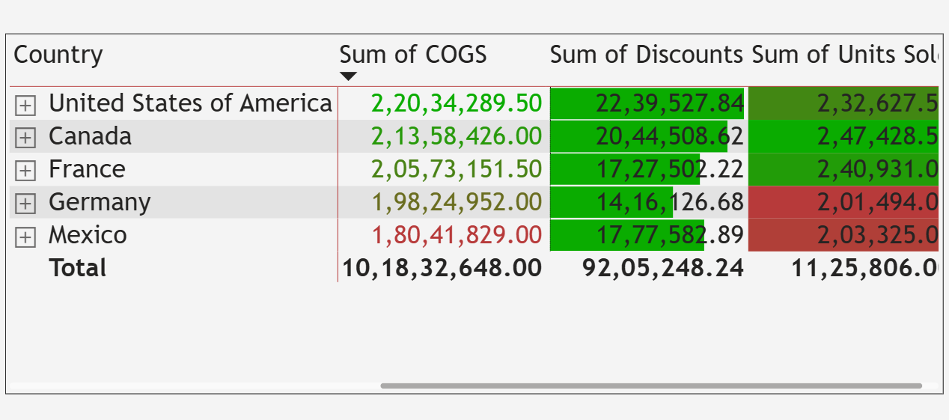

Slide 9
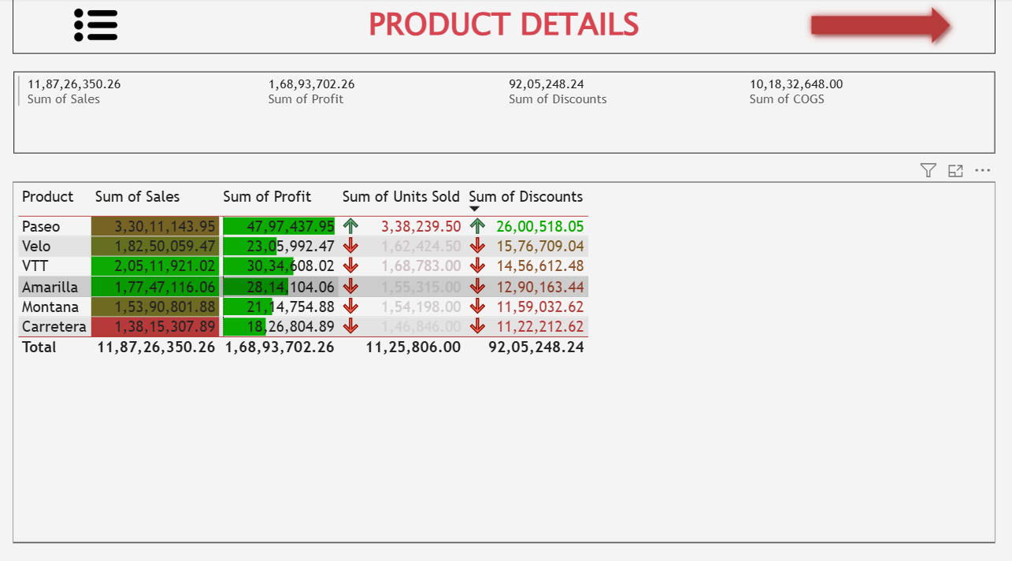

Slide 10

02
Why Use Conditional Formatting? : Smita Ravi Naik

Slide 11




Why Use Conditional Formatting?
To Improve Readability: It makes complex datasets easier to understand at a glance.
To Highlight Key Data: It draws the audience's attention to the most important metrics, trends, or outliers.
To Simplify Decision Making: By visually representing data, it helps stakeholders quickly grasp performance and make informed decisions.
To Enhance Engagement: It transforms a static report into a dynamic and interactive visual experience.

Slide 12

03
Where Can You Apply It? : Madhusudhan R

Slide 13


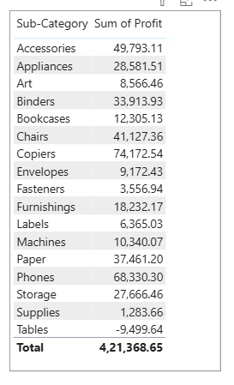
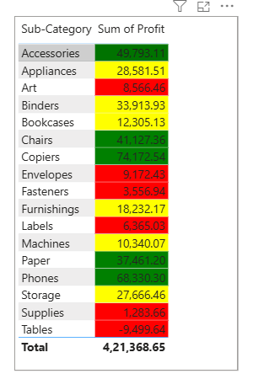
Where Can You Apply It?
1
Tables and Matrices: This is where conditional formatting is most often used. You can highlight rows, columns,
or individual cells to draw attention to specific data points.
2
Cards: Change the color of a card's value based on a condition, such as a sales figure hitting a certain target.
3
Gauge Visuals: Use conditional formatting to dynamically change the colors of the gauge based on a defined range.
4
Bar and Column Charts: Apply conditional formatting to change the color of the bars or columns based on their values.

Slide 14

04
Types of Conditional Formatting : Vinod Kumar

Slide 15




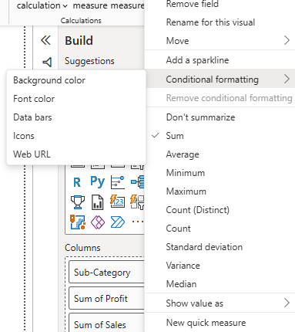
Types of Conditional Formatting
Background Color
Font Color
Data Bars
Icons
• Adds visual indicators like arrows or symbols
• Highlights cells with colored backgrounds based on values or rules
• Changes text color based on logic or thresholds
• Visual representation of value with horizontal bars

Slide 16

05
Applying Conditional Formatting : Mohammad Faiz

Slide 17


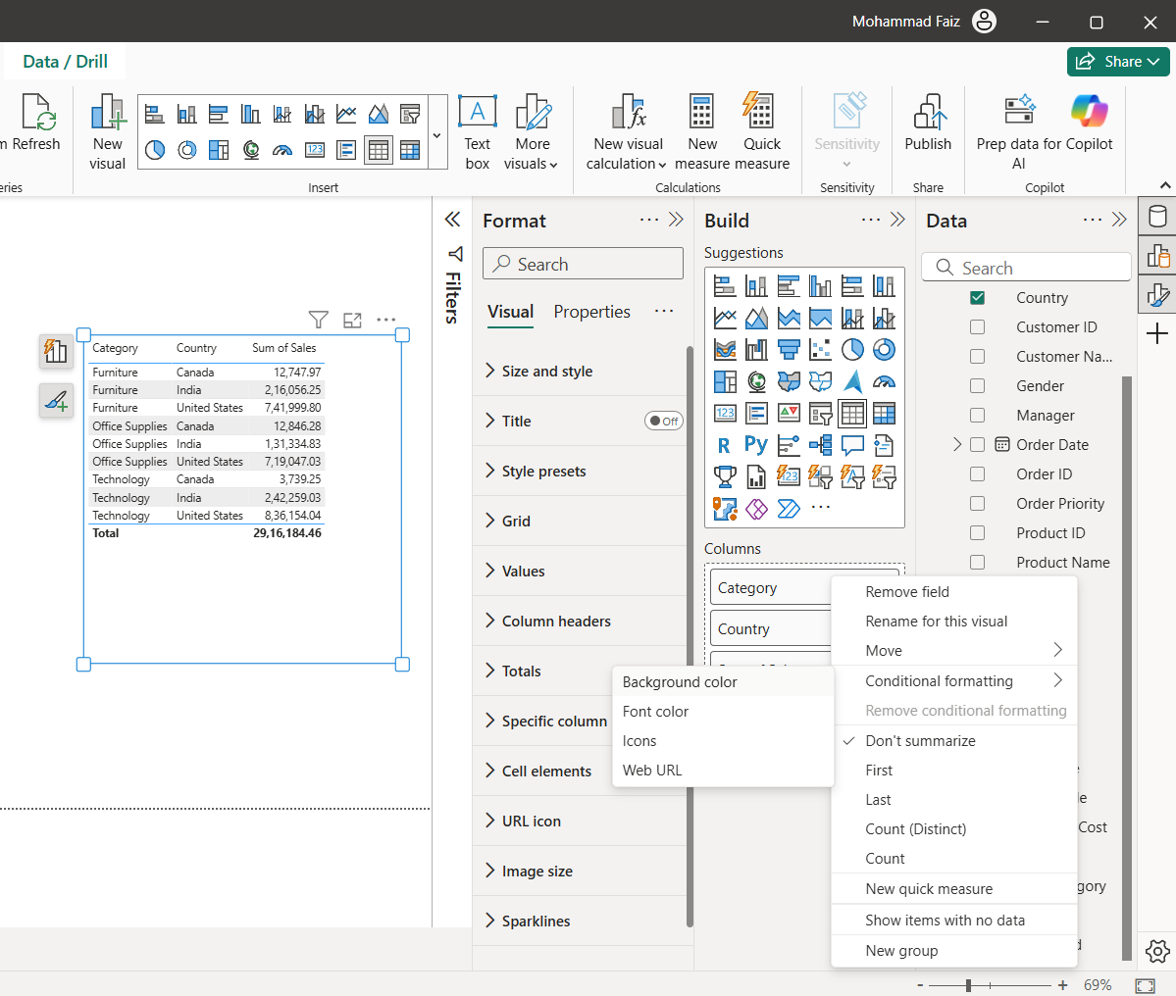
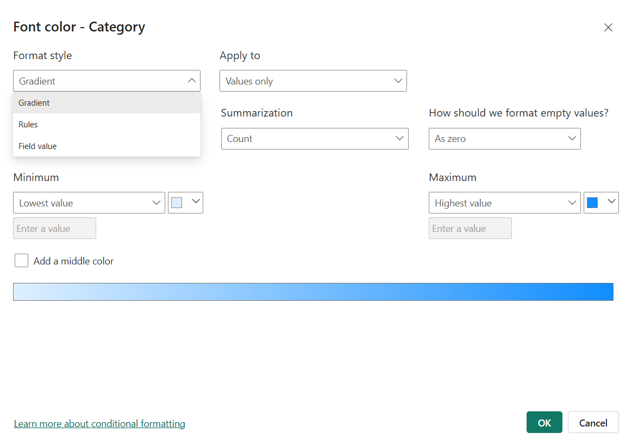
Applying Conditional Formatting
1
2
3
4
Select the visual (e.g., Table, Matrix, Card)
Go to the "Format" pane
Choose the field and formatting type (background, font, icon, data bars)
Select a rule type:
• Color scale
• Rules (Greater than, Less than, etc.)
• Field value based

Slide 18

06
Example – Background Color, Icons : Veena

Slide 19



Example – Background Color
Use conditional background color in a sales table
Color gradient from red (low sales) to green (high sales)
Helps instantly identify best and worst performing regions

Slide 20

Example – Icons
1
Use up/down arrows for profit changes
2
Set rules:
• Green up arrow for >10% growth
• Yellow dot for 0–10%
• Red down arrow for negative growth

Slide 21
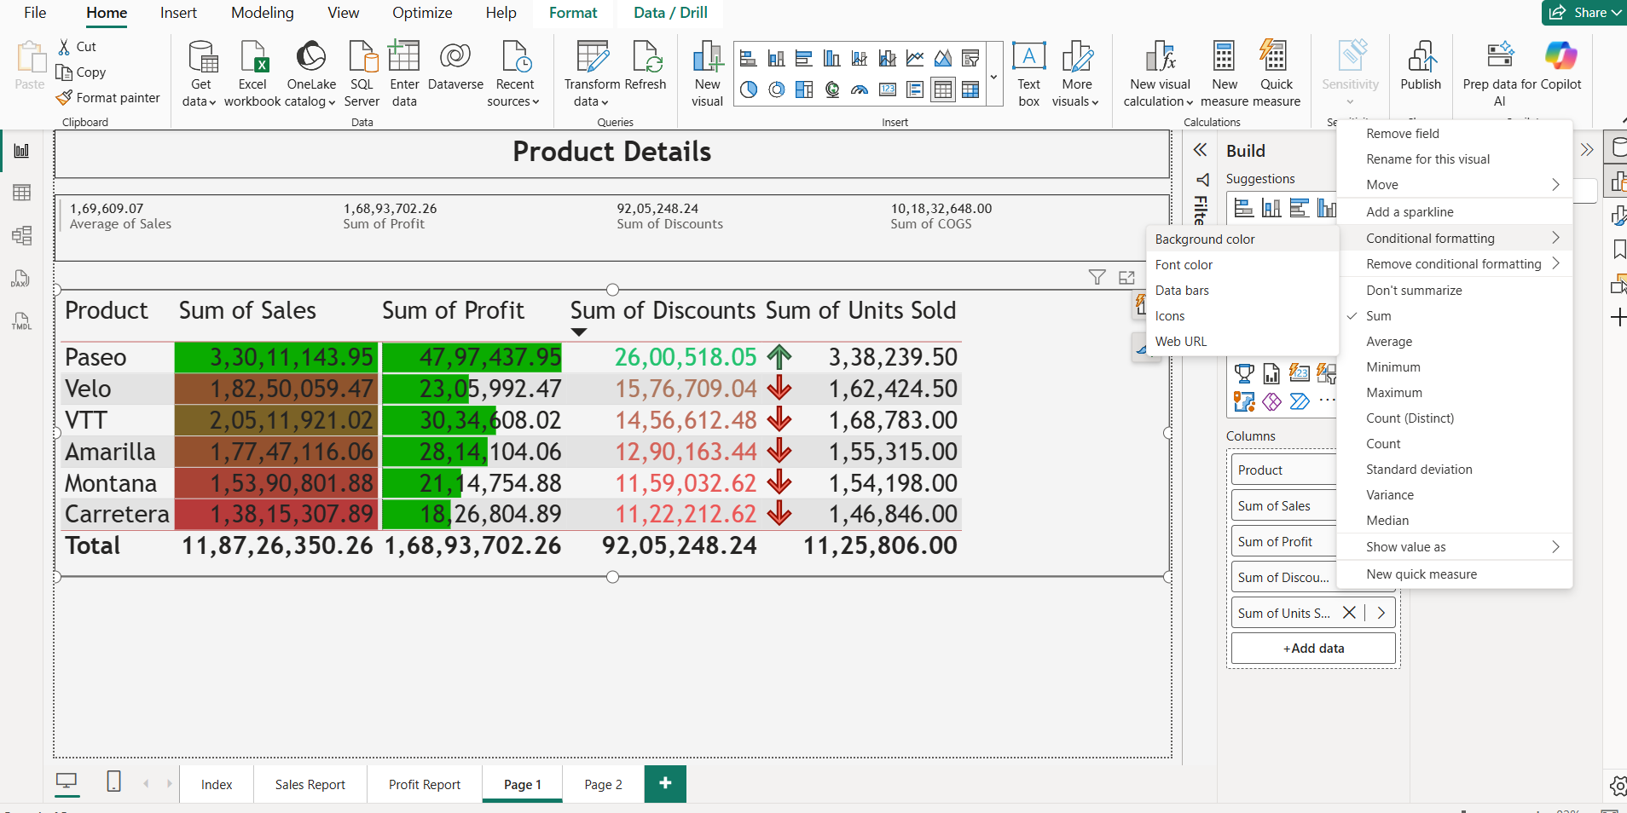
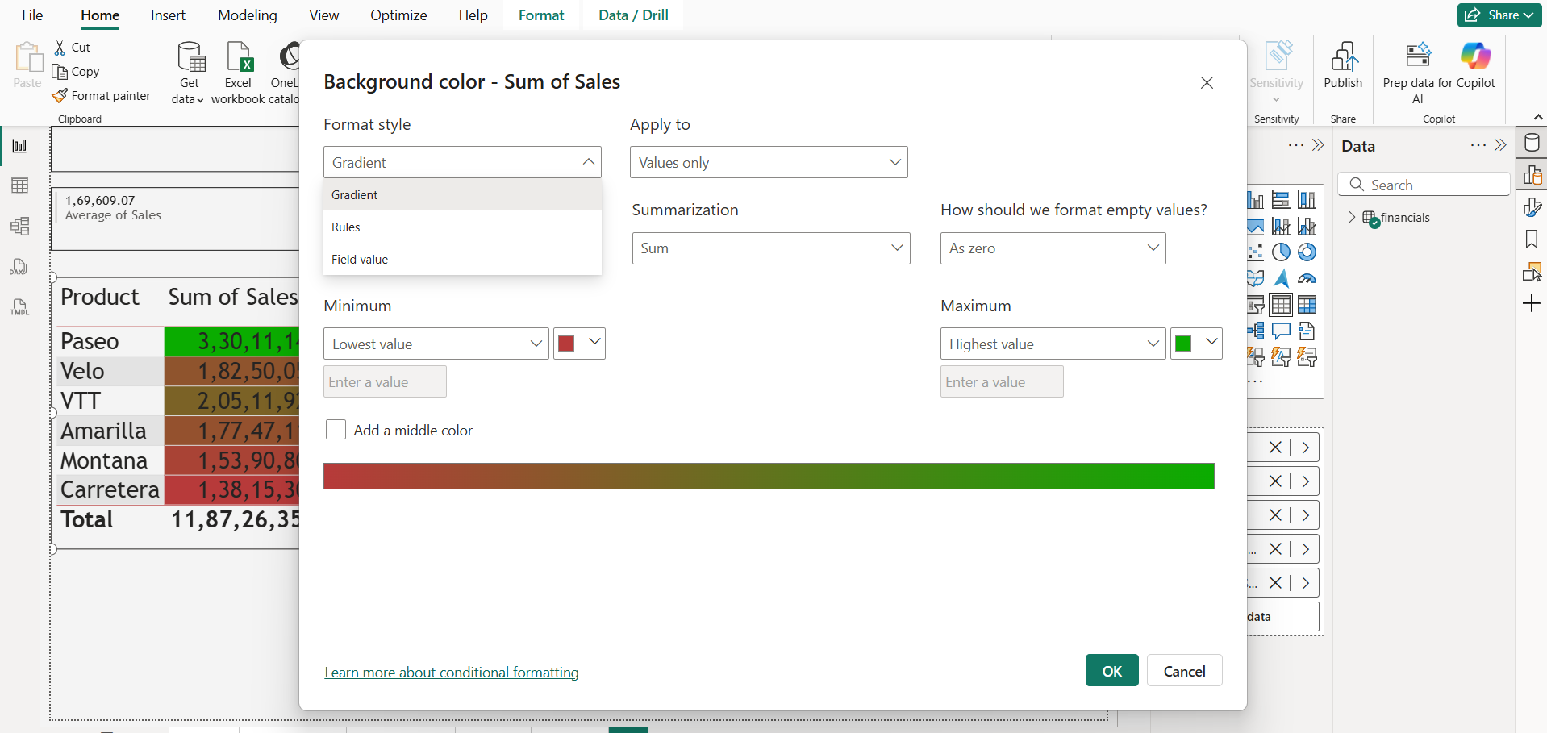

Slide 22
07
Field Value Based Formatting : Gaurav Ranjan Samal

Slide 23


Field Value Based Formatting
Dynamically format using values from other fields
Example: Highlight sales value based on profit margin
Enables cross-field visual logic

Slide 24

Conclusion
1
Conditional Formatting = Powerful visualization tool
2
Helps drive insights at a glance
3
Practice different types to become proficient

Slide 25

Thank You
“I hope you found this presentation informative”

